Slide 1
Researching Project IoT Platform using Laravel and Mobile App
‘ Week7 Report ’
Lecturer: Mr. HEL Chanthan
Prepared by Mr. VANNAK Sovannroth
2019-2020

Slide 2
Outline
Planning for First Month
Planning for Second Month
Download and install Flutter sdk Setup on Android Studio
Download, install Android Studio and create plugin for flutter sdk.
Create project, install SDK and AVD Manager
Run flutter and AVD Manager
View sample E-Commerce project with Emulator of Android
Coding for sample E-Commerce App
PAGE 01

Slide 3
Planning for First Month
Activity (Start on 06.08.2020) | Thursday (Presentation day) | Friday | Monday | Tuesday | Wednesday (Meeting day)
Week 1 | Installation MongoDB (Shell and Compass) and connect localhost between Shell and Compass.(Locally) | Performing CRUD (Create, Read, Update, Delete) on Mongo Shell and MongoDB Compass. | Creating MongoDB Atlas account and connect it to Mongo Shell or MongoDB Compass, and Driver (Node.js).(Cloud) | Installation Visual Studio Code and connect driver to MongoDB Atlas.(Cloud) | Connecting sample Backend to MongoDB Cluster and storing Products in the Database.
Week 2 | Connecting driver to Mongo Shell.(Locally) | Starting to build sample backend connect with or without MongoDB Atlas. | Build creating, editing and deleting Products on server. | Transmitting and fetching data to/from the Database. | Creating Login and Signup. (Email and password)
Week 3 | Learning template Bootstrap 4 | Install wampserver and Laravel | Run Laravel server with MySQL(Database) | Choose free template Bootstrap for Front-End & Backend | Installation Laravel Module for Backend and Front-End
Week 4 | Starting to build backend for project. & Creating Login and Signup. | User management: • Create new user • Reset user password • Delete and edit user | Manage Info: • Logo • Name • Contact info • Map • Social | Manage new category: • Create new category • Edit and delete exiting categories. | Manage news: • Post news • Edit news • Delete news
PAGE 02

Slide 4
Planning for Second Month
Activity (Start on 06.08.2020) | Thursday (Presentation day) | Friday | Monday | Tuesday | Wednesday (Meeting day)
Week 5 | Create Dashboard | Create Dashboard | Manage Calculate: • Addition • Subtraction • Multiplication • Division | Write API & Read API | Write API & Read API
Week 6 | Connect to ESP8266 or NodeMcu & fetch data from Arduino | Get data from Sensors and Calculate. | Show data on Dashboard | Connect Backend to Front-End | Front-End fetch data from Backend
Week 7 | Choose Flutter or React Native for build Mobile App. | Learning Flutter or React native | Start build sample project | Create Horizontal list view & build recent products grid view. | Manage Info: • Product details • Home page Ui modification • Shopping cart & list page • User login & Register • Contact info
Week 8 | Creating Users, brand and category on database & Adding products to the database. | Auto complete search for categories and brands & Uploading Images to firebase. | Login and signup screen redesign & Google sign in for IOS and Android . | Firebase Auth using provider package & Dashboard UI/UX and Database product modeling. | Load products from firebase part & loading products from database.
PAGE 03

Slide 5
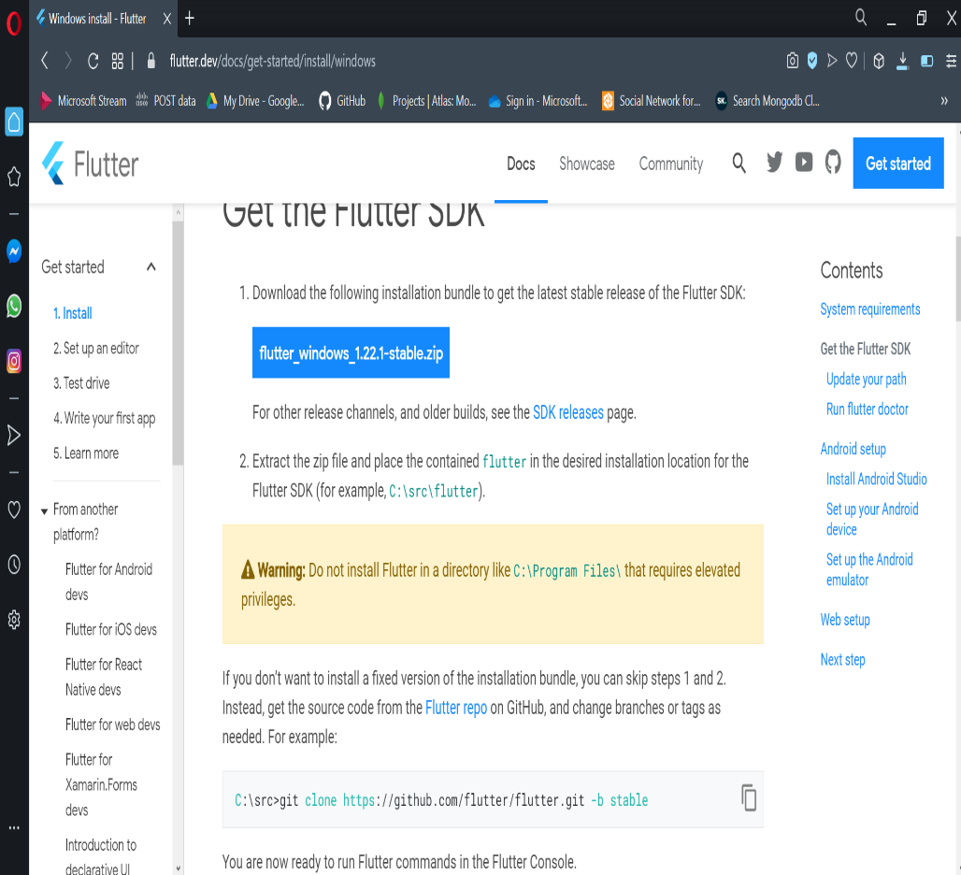
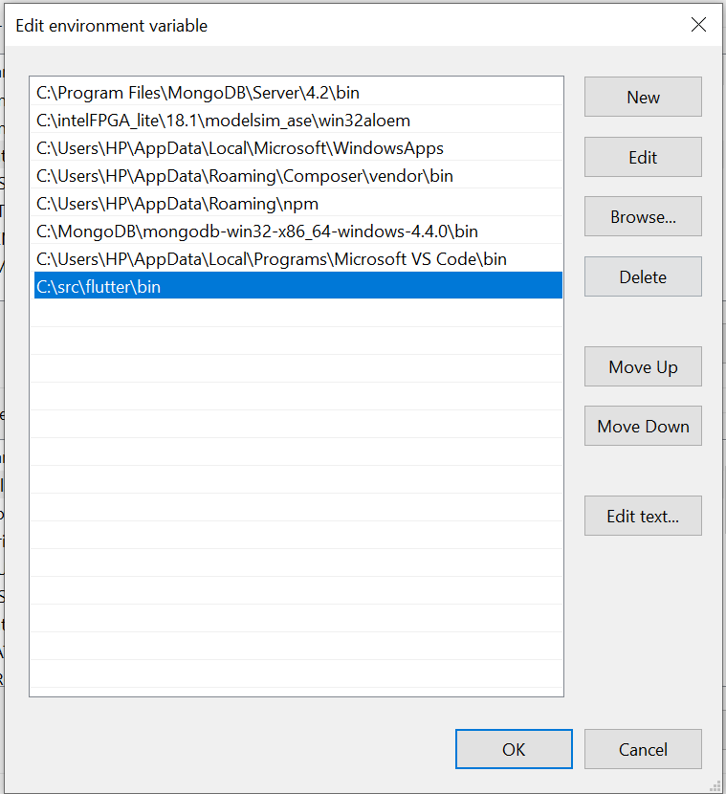
Download and install Flutter sdk Setup on Android Studio
Step for installation Flutter sdk:
1. Pass folder of Flutter in path C:\src\flutter
2. Pass C:\src\flutter\bin on Path of Edit Environment Variable.
3. Run command “flutter doctor” on cmd.
PAGE 04

Slide 6
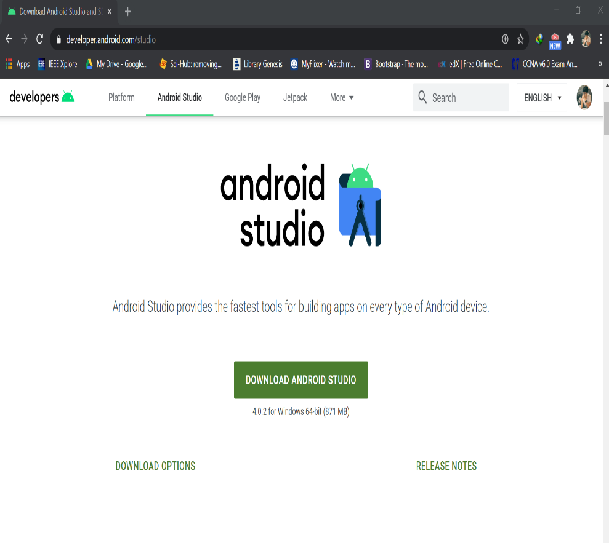
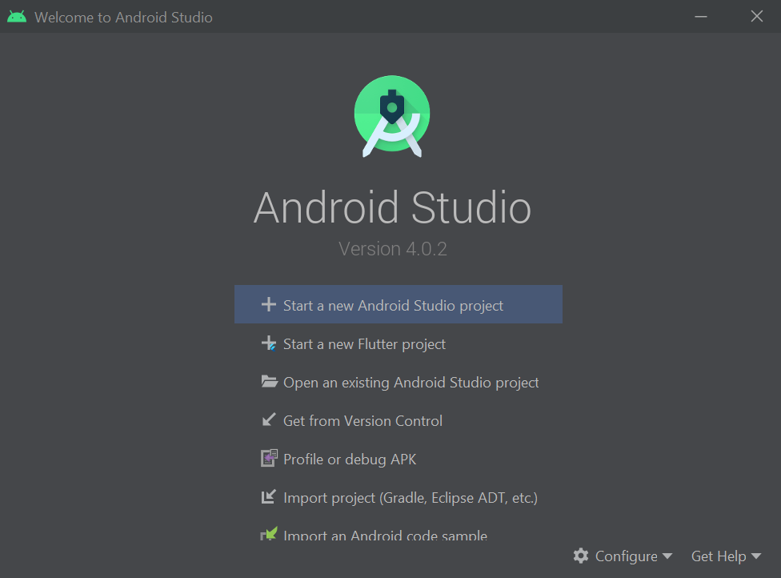
Download, install Android Studio and create plugin for flutter sdk.
Step for create plugin flutter :
click on configure->plugins->search flutter and install it->restart.
PAGE 05

Slide 7
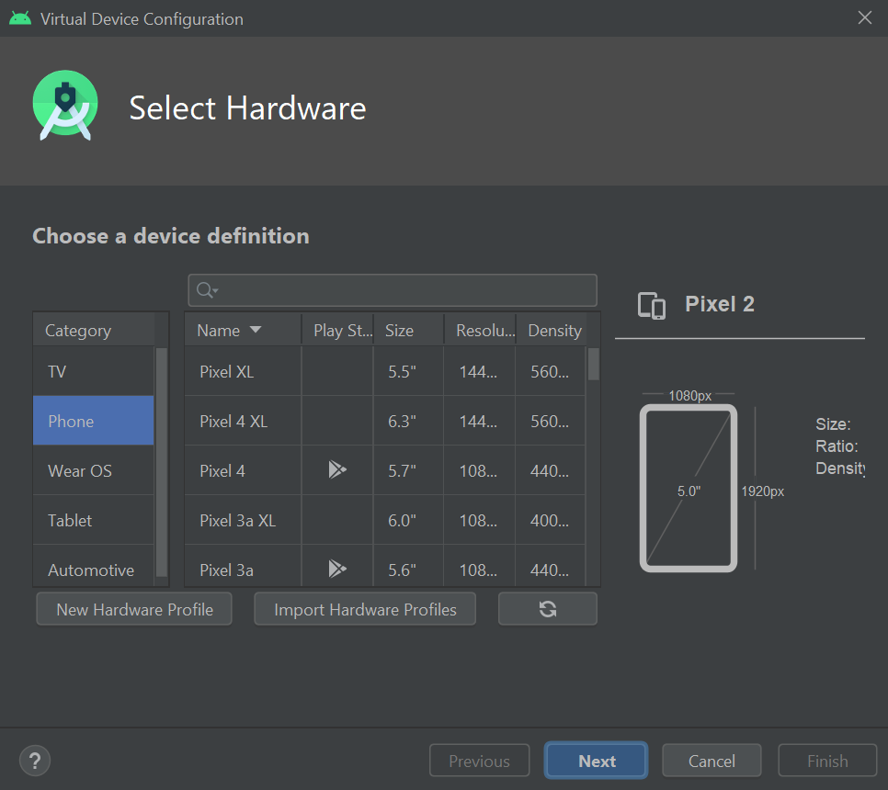
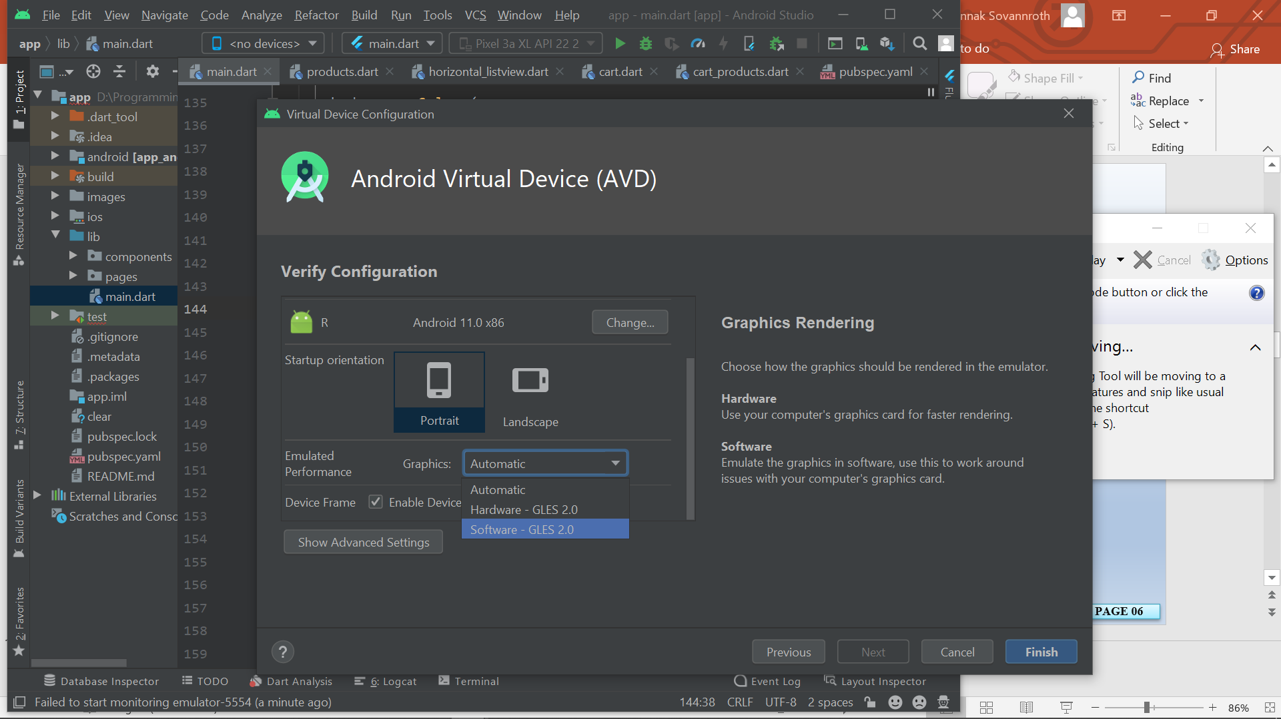
Create project, install SDK and AVD Manager
Install SDK Manager.
Click AVD Manager->Create Virtual Device->choose version of AVD and download it->show advance setting->software->finish
PAGE 06

Slide 8
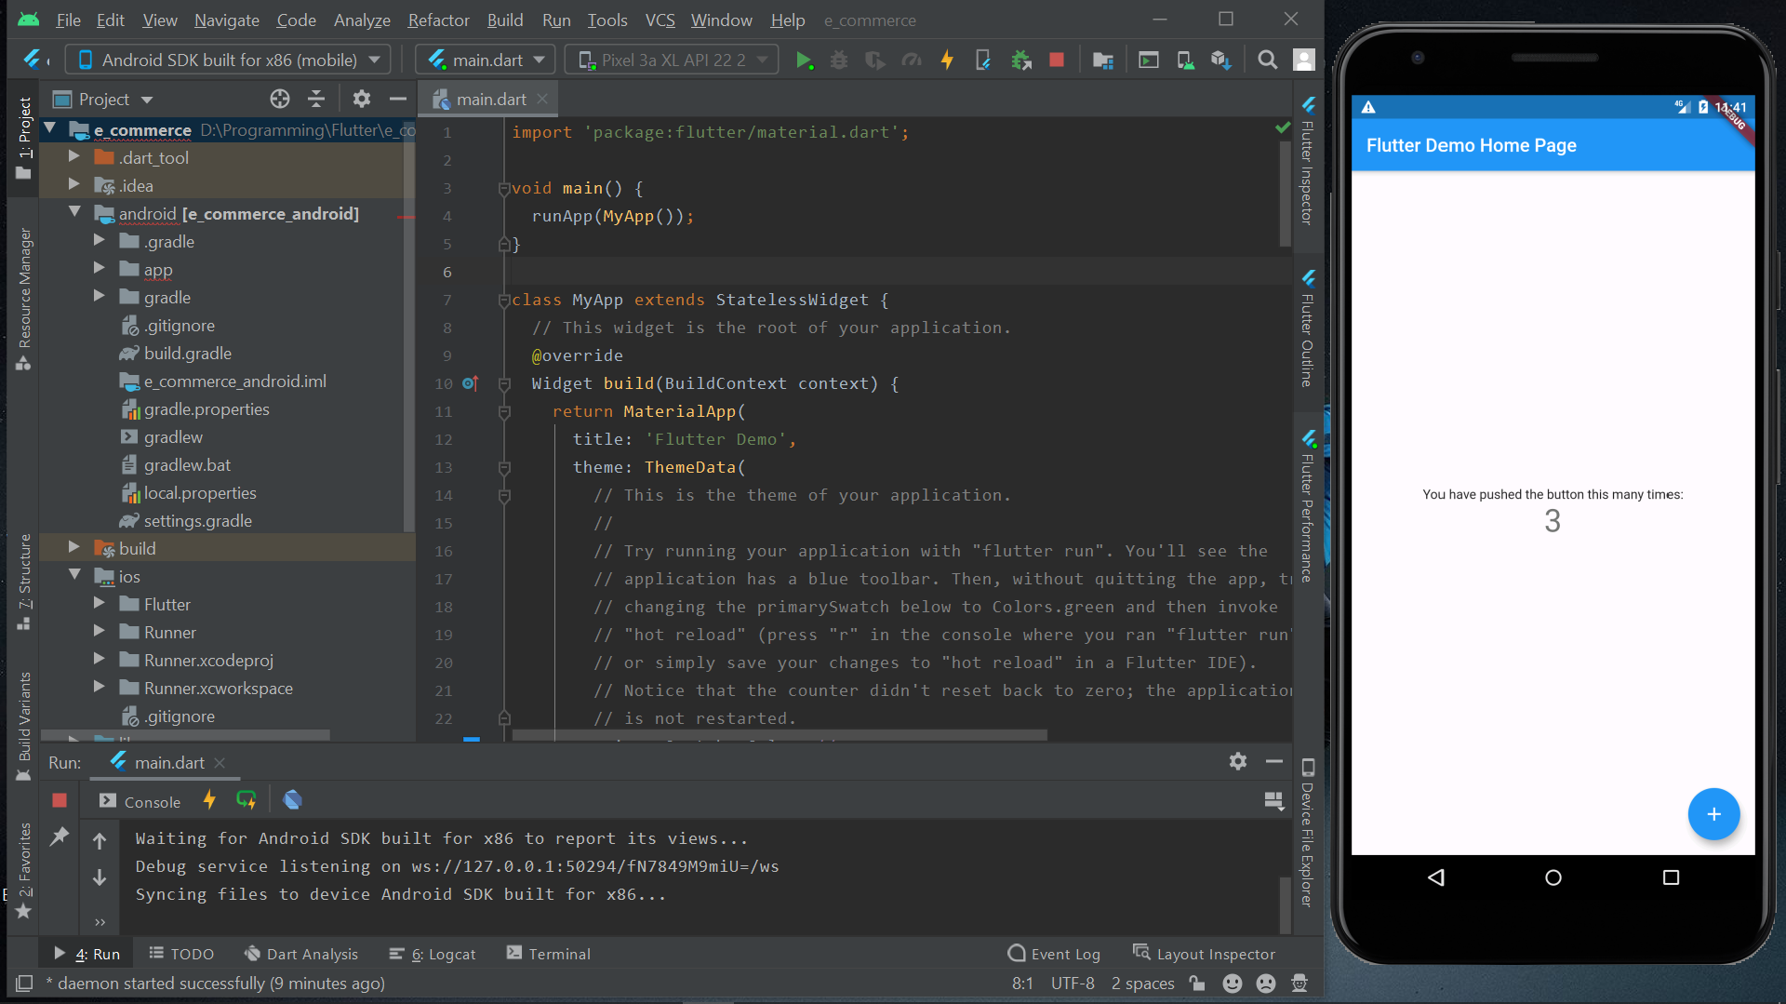
Run flutter and AVD Manager
PAGE 07

Slide 9
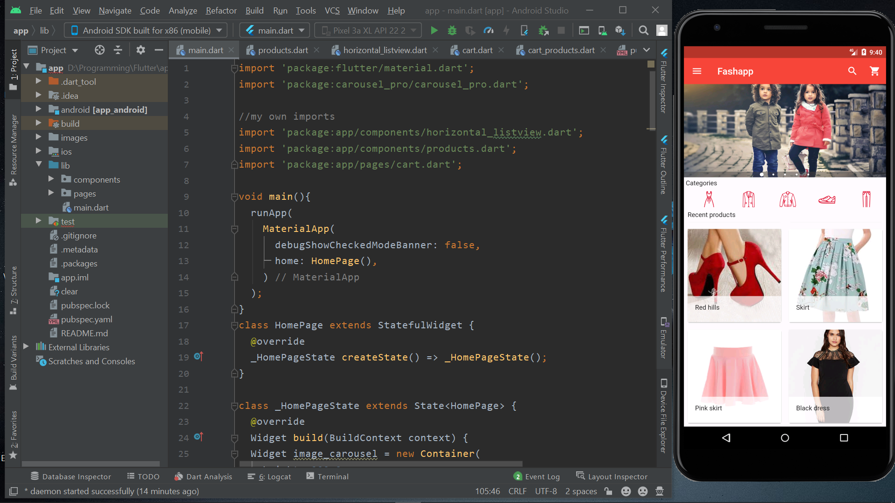
View sample E-Commerce project with Emulator of Android
PAGE 08

Slide 10
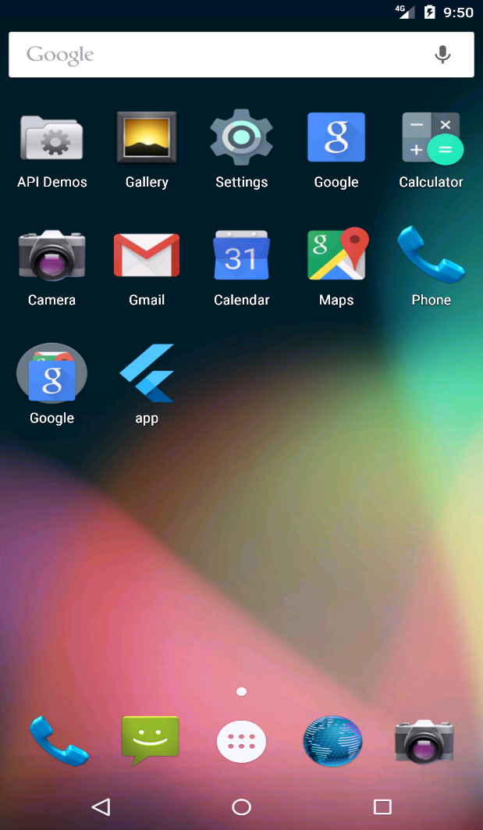
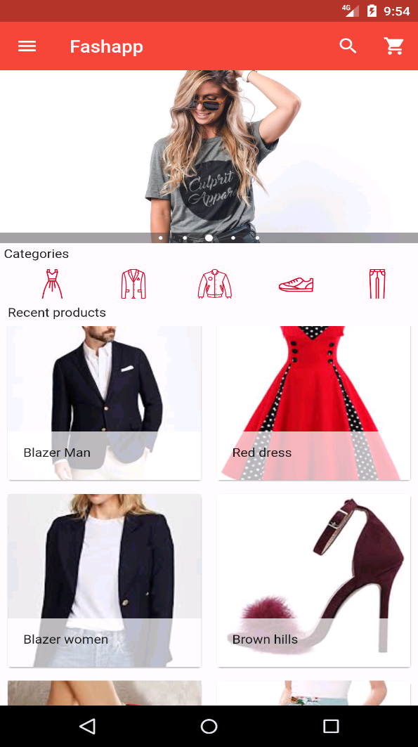
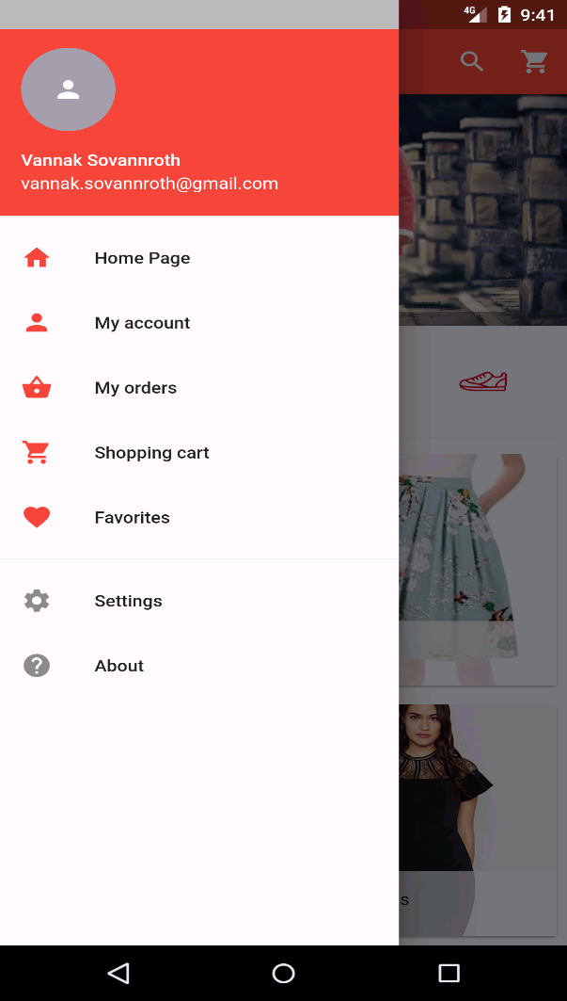
How to view Charts from JavaScript
PAGE 09

Slide 11
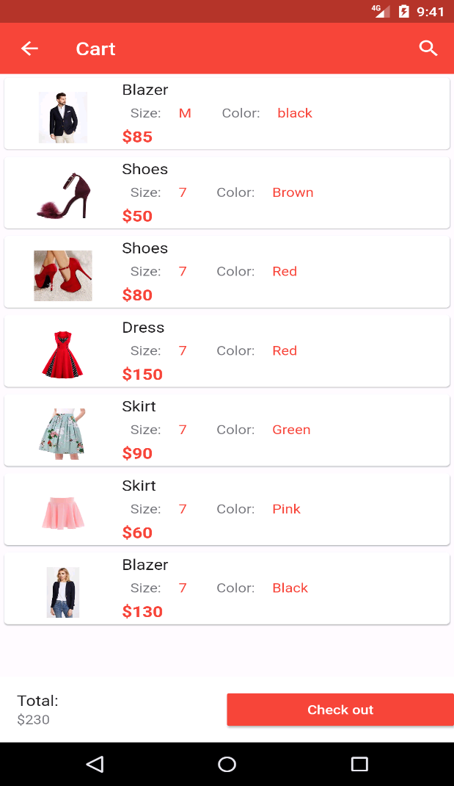
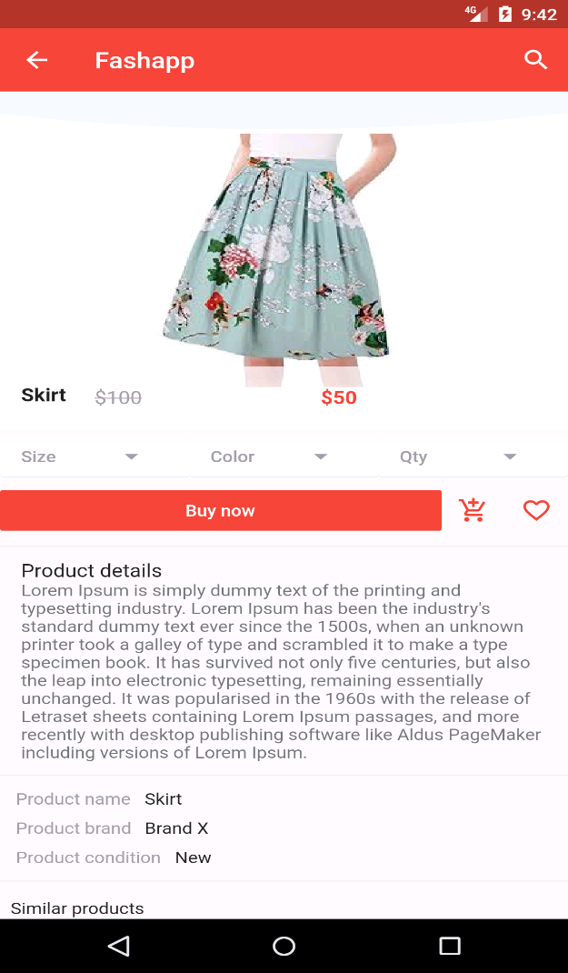
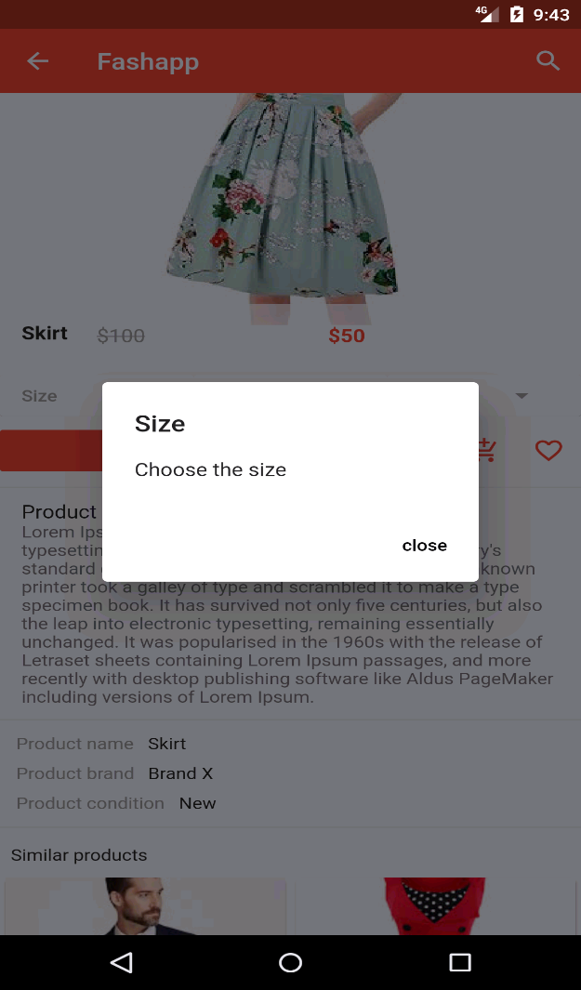
How to view Charts from JavaScript
PAGE 10

Slide 12
Coding for sample E-Commerce App
https://github.com/Chanthan89/Smart-Irrigation/tree/master/Weekly%20Presentation/October/VANNAK%20Sovannroth/e-commerce
References
https://youtu.be/Z2ugnpCQuyw
https://youtu.be/8YlJ9RjdpkA
https://www.youtube.com/watch?v=Dy_zBF6rJFc&list=PLmnT6naTGy2SC82FMSCrvZNogg5T1H7iF
PAGE 11

Slide 13
Thank You!

